Slide 1
Snack Ordering app for a movie Theater
Rasika Mathur

Slide 2
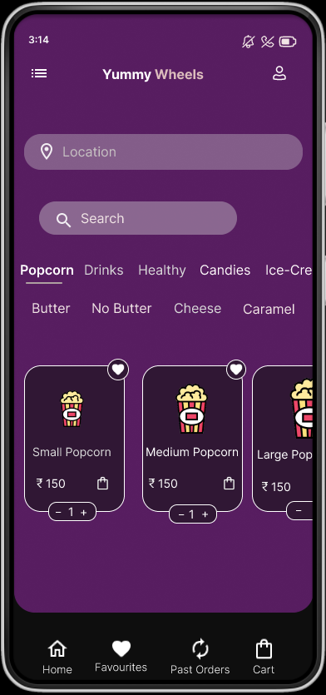
Project overview
The product:
Yummy wheels is an online food delivery app. That allows its users to order snacks during a movie at the theater any time.This app is great for family who wants to watch movie and even don’t get disturbed.
Project duration:
March 2022 to August 2022

Slide 3
Project overview
The problem:
Users don’t want to get disturbed during a movie or don’t want to stand in long que.
The goal:
The goal of the project is to allow the users to order food online just by using the app and get the order to their seats.

Slide 4
Project overview
My role:
UX designer designing an app for Yummy wheels from conception to delivery.
Responsibilities:
Conducting interviews, paper and digital wireframing, low and high-fidelity prototyping, conducting usability studies, accounting for accessibility, and iterating on designs.

Slide 5
User research
Personas
Problem statements
User journey maps
Understanding
the user

Slide 6
User research: summary
I conducted interviews and created empathy maps to understand the users I’m designing for and their needs. A primary user group identified through research were parents who wants to enjoy the movie with family but gets disturbed with the child as the child Is hungry.
This user group confirmed that as they are too busy with work but love watching movies together but due to the child they are not able to watch the movie without disturbance.

Slide 7
User research: pain points
1
2
3
Age
Accessibility
Pain point
As some users can’t wait in long queue they can easily order from this app and the food gets delivered in their place.
Previously There was no such technology available for theater.
Text-heavy menus in apps are often difficult to read and order from.

Slide 8

“I’m busy during weekdays but love watching movies on weekends”
Persona: Manan
Goals
To make users happy with the product.
To give them comfort and easy delivery..
Frustrations
The children don’t allow to watch movie as they are not interested and cannot leave them alone.
Ordering may take some time.
Problem statement:
Manan is a busy working adult who likes watching movies with his family but as his child is small and disturbs him while watching movie.Since Manan dosen’t like going to the theater due to this reason. As he was introduced with the app he was happy that his child will now not disturb him whenever he is hungry Manan orders snacks online and and enjoys the movie without getting up from his seat.
Age:
Education:
Hometown:
Family:
Occupation:
35
Graduated
Hyderabad
Married
Works at Wipro
Manan is a busy working parent who likes watching movies, but cannot go as his child does not allow him to watch movies and keeps on disturbing him. Manan found an app which delivers food in theatre. Now Manan is happy as he can watch movie without even getting up from his seat and the food will be delivered on time.

Slide 9
Persona : Manan
An easy and quick way to order.
User journey map
ACTION | Select Food | Browse Menu | Place order | Complete order
TASK LIST | Tasks A.Decided on food type. B. searched for menu. C. selected type of food. | Tasks Browse online menu. B. Select menu items. | Tasks Place order. B. Enter details like Seat number, screen number,Phone numer to contact. | Tasks Confirm order. B. Provide Payment Information.
FEELING ADJECTIVE | Overwhelmed by number of options. | Confused Annoyed | Dissatisfied with scrolling to add details. | Frustrated to enter card details as it’s a movie theater and cannot see the details in dark.
IMPROVEMENT OPPORTUNITIES | Create a dedicated mobile app for Yummy wheels. | Provide search filter. Include images. | Provide simple checkout flow. | Provide options for cash payments.
Mapping Manan’s user journey revealed how helpful it would be for users to have access to a dedicated Yummy Wheels app.

Slide 10
Paper wireframes
Digital wireframes
Low-fidelity prototype
Usability studies
Starting
the design

Slide 11
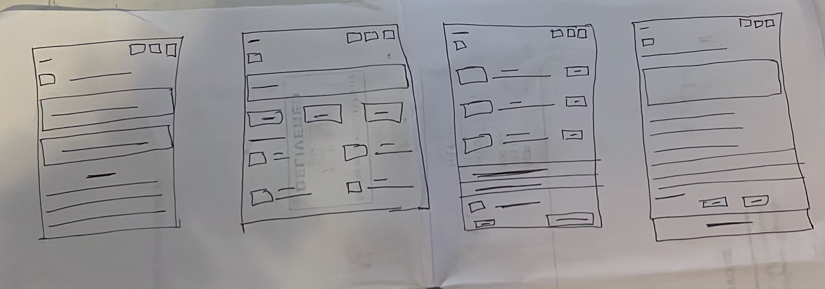
Paper wireframes
Taking the time to draft iterations of each screen of the app on paper ensured that the elements that made it to digital wireframes would be well-suited to address user pain points. For the home screen, I prioritized a quick and easy ordering process to help users save time.

Slide 12
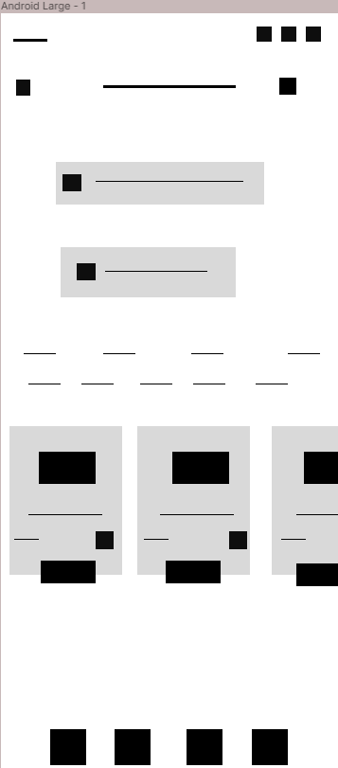
This icon on top takes the user to the Menu icon where he can access payment details, address book, etc.
Digital wireframes
As the initial design phase continued, I made sure to base screen designs on feedback and findings from the user research.
This button at the top of the home screen makes it easy to search what they like to eat.

Slide 13
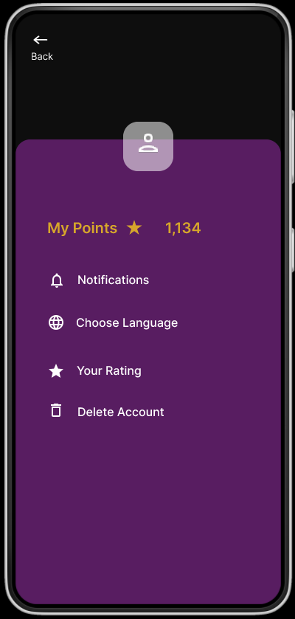
Digital wireframes
Easy access to navigation that’s screen reader friendly.
Easy navigation was a key user need to address in the designs in addition to equipping the app to work with assistive technologies.

Slide 14
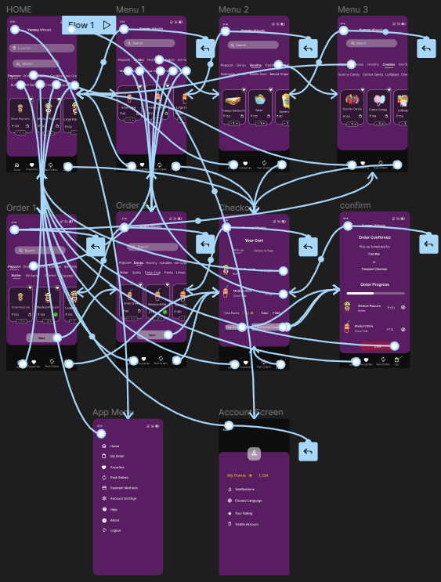
Low-fidelity prototype
Using the completed set of digital wireframes, I created a low-fidelity prototype. The primary user flow I connected was ordering, so the prototype could be used in a usability study.
View the Yummy Wheels
https://www.figma.com/file/bJ5DbFqlTxoPNXGfPE5ssW/Snack-ordering-app-for-theater?node-id=0%3A1

Slide 15
Usability study: findings
. I conducted two rounds of usability studies. Findings from the first study helped guide the designs from wireframes to mockups. The second study used a high-fidelity prototype and revealed what aspects of the mockups needed refining.
Round 1 findings
Round 2 findings
1
Users want to order quickly
1
Payment option is confusing
2
Users want custromization options.
2
Adding delivery instructions is difficult.
3
Users want contact less delivery.

Slide 16
Refining
the design
Mockups
High-fidelity prototype
Accessibility

Slide 17
Before usability study
After usability study
Mockups
Early designs allowed for some customization, but after the usability studies, I added additional options.

Slide 18
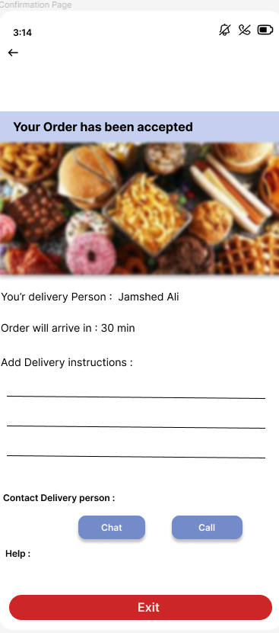
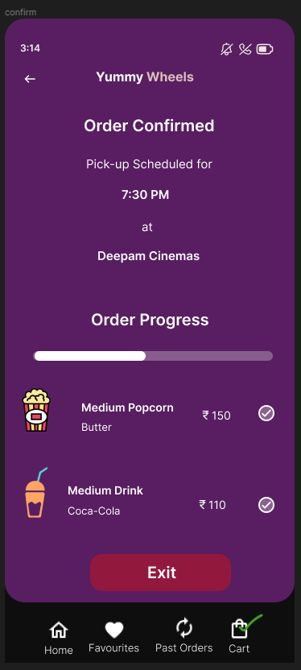
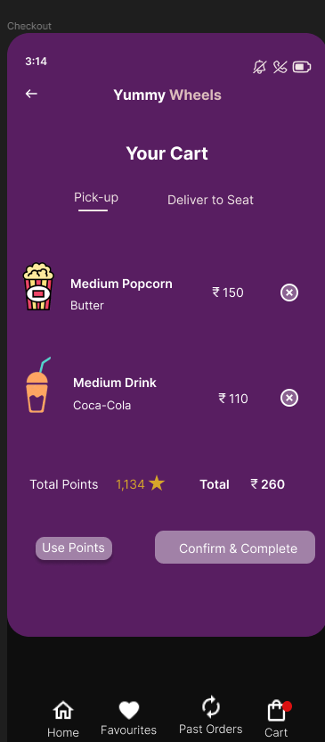
Mockups
The second usability study revealed frustration.
After usability study
Before usability study

Slide 19
Mockups

Slide 20
High-fidelity prototype
The final high-fidelity prototype presented cleaner user flows for Selecting the items and checkout. It also met user needs for a pickup or delivery option as well as more customization.
View the Yummy Wheels
https://www.figma.com/file/bJ5DbFqlTxoPNXGfPE5ssW/Snack-ordering-app-for-theater?node-id=0%3A1

Slide 21
Accessibility considerations
1
2
3
Provided access to users who are vision impaired through adding alt text to images for screen readers.
Used icons to help make navigation easier.
Used detailed imagery to help all users better understand the designs.

Slide 22
Going forward
Takeaways
Next steps

Slide 23
Takeaways
Impact:
The app makes users feel like Yummy Wheels really thinks about how to meet their needs.
.
What I learned:
While designing the Yummy Wheels app, I learned that the first ideas for the app are only the beginning of the process. Usability studies and peer feedback influenced each iteration of the app’s designs.
One quote from peer feedback:
“ The app made it so easy for the us to order snacks from our seats, with understandable icons, Navigation icons.”

Slide 24
Next steps
1
2
Conduct another round of usability studies to validate whether the pain points users experienced have been effectively addressed.
.
Conduct more user research to determine any new areas of need.

Slide 25
Insert a few sentences summarizing the next steps you would take with this project and why. Feel free to organize next steps in a bullet point list.
Let’s connect!
Thank you for your time reviewing my work on the Yummy Wheels app! If you’d like to see more or get in touch, my contact information is provided below.
Email: rasika.mathur30@gmail.com

Slide 26
Thank you!

